Slide 1

Arabic
العربية
a Language in 10 minutes
Ahmed El Kholy

Slide 2
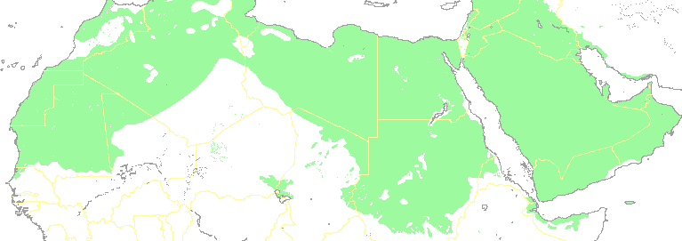
Language Profile
Belongs to Semitic languages Family
  such as Hebrew and Aramaic
It is spoken by more than 280 million people
  Middle East and North Africa
Official language of 22 countries
The liturgical language of Islam
One of the six official languages of the UN
Arabic script is used to write many languages: Arabic, Persian, Kurdish, Urdu, Pashto, etc.

Slide 3
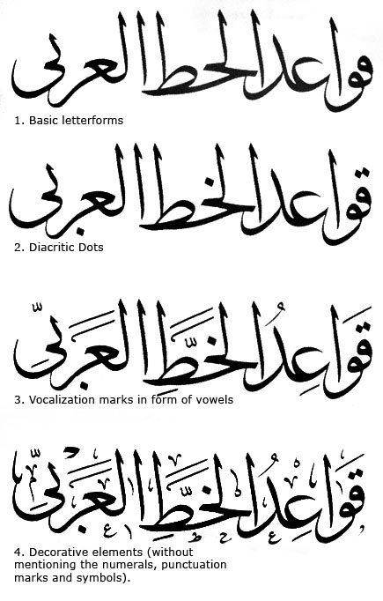
Arabic Script
Letter forms, dots and diacritics
http://29letters.wordpress.com/2007/05/28/arabic-type-history/

Slide 4
Arabic Script
Letter Shapes
No distinction between print and handwriting
No capitalization
Right-to-left
Ambiguous
shapes
Connective
letters
Disconnective
letters(كتابها)
ز
د
ا
ن
ب
ك
م
ش
ﻍ
Stand alone
ﻧ
ﺑ
ﻛ
ﻣ
ﺷ
ﻏ
initial
ﺰ
ﺪ
ﺎ
ﻨ
ﺒ
ﻜ
ﻤ
ﺸ
ﻐ
medial
ﻦ
ﺐ
ﻚ
ﻢ
ﺶ
ﻎ
final
Notes:
Con / dis
Similar shapes
Very different forms

Slide 5
Morphology
Nouns
poss
plural
Stem
article
prep
conj
وكبيوتنا
/wakabiyūtinā/
نا + بيوت + ك + و
wa+ka+buyūt+nā
and+like+houses+our
And like our houses
وللمكتبات
/walilmaktabāt/
و+ل+ال+مكتبة+ات
wa+li+al+maktaba+āt
and+for+the+library+plural
And for the libraries
Morphotactics (e.g. ل+ال → لل l+Al→ll)
Arabic Broken Plurals (templatic)
Stem = Root + Pattern (e.g. ktb+ma12a3a → maktaba)
Notes:
Article or poss
Case
Arabic Broken Plurals
Intersection of Derivational and Inflectional Morphology

Slide 6
Syntax
Verbal sentences
  [Verb Subject Object] (VSO)
  كتب الاولاد الاشعار
  Wrote the-boys the-poems The boys wrote the poems
Copular sentences
  [Topic Complement]
    Noun/Adjective/Adverb
      الولد ذكي
      the-boy smart The boy is smart
    Prepositional Phrase
      الولد في المكتبة the-boy in the-library The boy is in the library
    Verb-Sentence (~SVO)
      الاولاد كتبوا الاشعار
      [the-boys [wrote-they poems]] The boys wrote the poems
Notes:
Traditional analysis

Slide 7
Masculine & feminine / Grammar Cases
Masculine & feminine
The Arabic language has three cases,
  The nominative case (subject) in Arabic ‘ar-raf3(u) الرَّفْعُ
  The accusative case (object) in Arabic ‘an-nasb(u) النَّصْبُ
  The genitive case (to denote possession) ‘al-jarr(u) الْجَرُّ

Slide 8
Tense / singular & plural
Past, present, and future tenses
Singular, dual, and plural forms

Slide 9
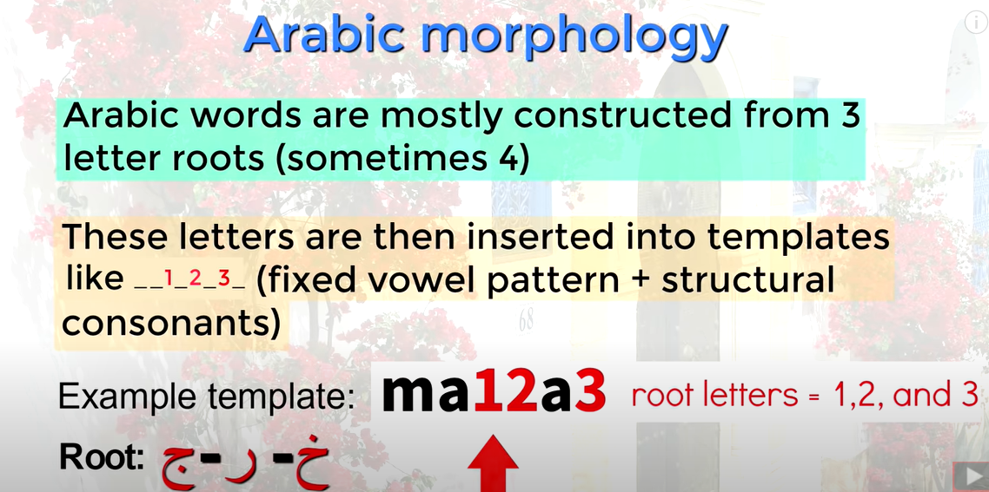


Slide 10
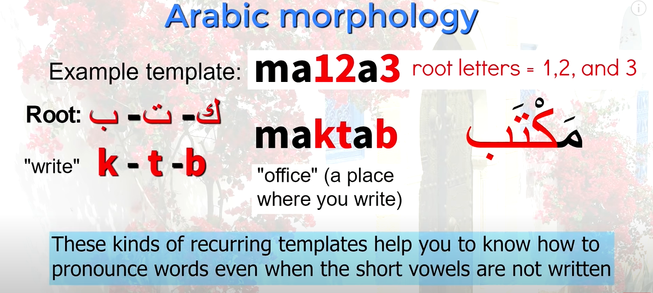

Slide 11
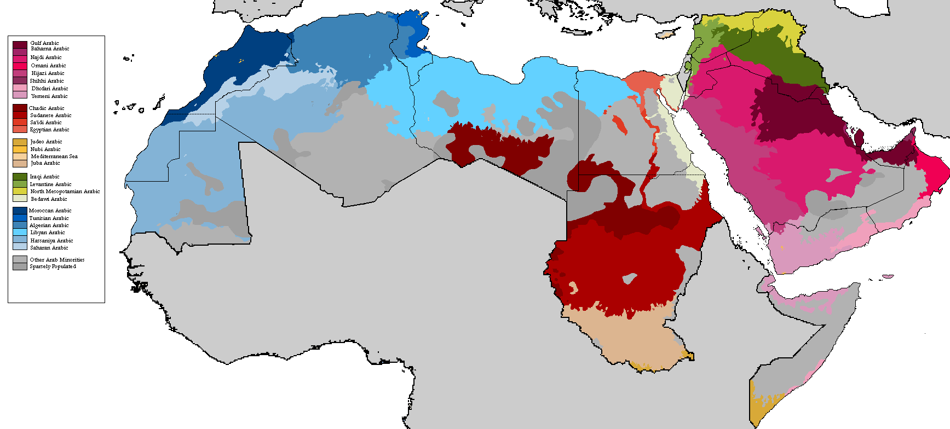
Dialects
Many colloquial Arabic variants throughout the Arab World
Dialects differ radically from the literary language
Main Divisions: North African, Egyptian, Levantine, Gulf
Some of these dialects are not mutually comprehensible

Slide 12
Computational Efforts
There has been a great interest in Arabic in the last decade
Resources
  Monolingual Corpora: e.g., Arabic Gigaword
  Parallel Corpora: e.g., UN corpus, Arabic News corpus, etc.
  Treebanks: e.g., Arabic Penn Treebank, Prague Dependency treebank, Columbia Arabic Treebank
  Resources for OCR, ASR, IR, etc.
Main Data Distributors
  Linguistic Data Consortium
  ELDA Evaluation and Language resources Distribution Agency

Slide 13
Computational Efforts
Online MT systems
  Google Translate, Sakhr, etc.
Online paper collections
  ACL Anthology (hundreds of papers); MT archive (> 200 papers)
Good starting points
  Habash. 2010. Introduction to Arabic NLP <http://www.morganclaypool.com/doi/abs/10.2200/S00277ED1V01Y201008HLT010>
  Tutorials from Columbia Arabic Dialect Modeling Group <http://www1.ccls.columbia.edu/~cadim/>

Slide 14
References
The Arabic Language: Its Amazing History and Features https://www.youtube.com/watch?v=nDg3yPSzsEg

Slide 15


